Slide 1
Elastic Search Introduction
Vijay Kumar NM

Slide 2
Introduction
Open Source Search based on Apache Lucene, written in Java
Full-text search, real-time analytics of structured data, or a
combination of the two
Cross – platform
Big focus on scalability – distributed from ground up
Designed to take data from all node, analyze it and search through it

Slide 3
Few companies which use elastic search
Wikimedia
Mozilla
Quora
Foursquare
Sound Cloud
GitHub
Stack Exchange and more …

Slide 4
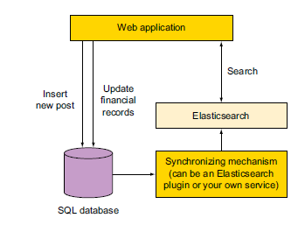
Communication with the search server is done through a HTTP REST API
curl –X <rest verb> <node>:<port>/<index>/<type>/<id>
curl –X GET http://localhost:9200/person/employee/123
Schema less JSON documents
Near Real time --- distributed and scalable architecture [sometimes takes 1 seconds] change in document can be searched quickly
Popular because easy to use [its like a plug and play]
Can be used as datastore but not suggested, as it is not
good in relating data

Slide 5
Terminology
Cluster: Collection of Nodes
All the nodes together contain all the default
As many nodes as you want!
Need not worry about which node data is present, it searches against all the nodes.
Default name (elastic search)
Node:
Single server which stores searchable data
If node is single, it has all the data or else it will have subset of data
Default name: (marvel characters)

Slide 6
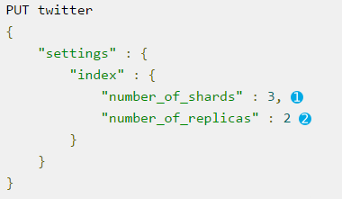
Index:
Collection of mappings, it is similar to database in relationship world
We can have as many indexes as you want in a cluster
Names must be lower cased
Type:
Represent a class/category of similar documents
It has name and mapping
It can said as table in elastic search world
stored with in a meta field with _type [lucene does not have this concept], applying _type is like filter in lucene

Slide 7
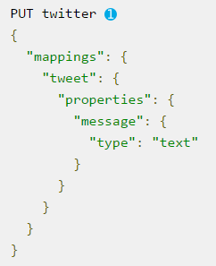
Mapping
Scheme of a table in relation database world
Defines the fields that a document of a given type may have
Includes the data type for each field, eg. String, integer, data
Also includes information on how fields should be indexed and stored by lucene.
Dynamic mapping means that it is optional to create mapping,
If the mapping is not found will create mapping based on data you index

Slide 8
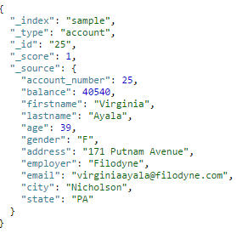
Document
Basic unit of information can be indexed
Key value pairs
A value can be text, date, integer
Documents are expressed as json
Documents can be rows in relational
database table
Meta fields
Stores meta data
Prefixed with _

Slide 9
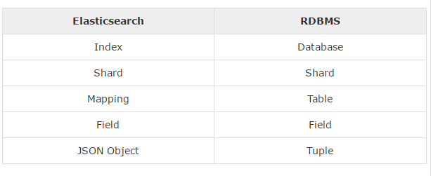

Slide 10
Inverted Index
This is similar to database index we do in relational database world
What is different?
Analysis
Tokens

Slide 11
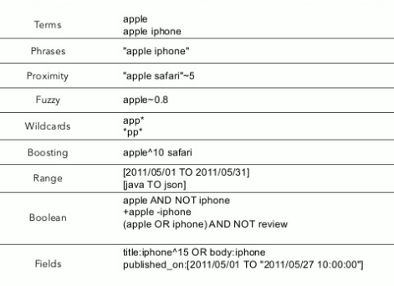
Searching
By Query String
GET http://localhost:9200/ecommerce/product/_search/q=pasta
Will search all fields by default
Simple and adhoc queries
_search api provided by elastic search

Slide 12
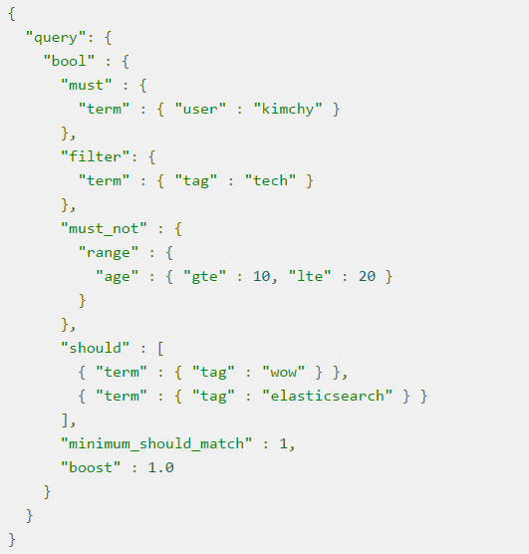
Query DSL
Search by defining queries within
the request body in JSON
Supports more features than the
query string approach

Slide 13
Searching – query and filter
Query: how well the document match [will effect scores]
Filter : will the document actually match – this just removes from the search completely – faster
Based on this we have Relevancy and Score
What is Relevancy? (TF/IDF)

Slide 14
What type of searches can we do?
Full Text Search
Show the documents by _score meta fields
Relevance – (TF/IDF) Term frequency / Inverse Document Frequency
TF: How often does the term appear in the field?
IDF: How often does each term appear in the index? The more often, the less relevant. Terms that appear in many documents have a lower weight than more-uncommon terms.
Analysis – breaks into token to do analysis
these are all queries not filters!

Slide 15
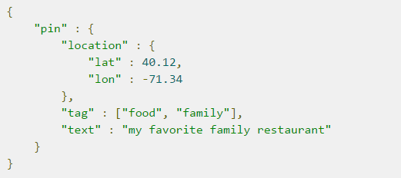
Structured search
Structured search is about interrogating data that has inherent structure.
Ex: Dates, times, and numbers are all structured:
Range Queries are examples
Result would be either yes or no
Structured search does not worry about document relevance or scoring; it simply includes or excludes documents
We have bool query to make conditional statements
Geobased search
No need to use Haversine formula
Pretty easy query to get all the documents
which has location with in 0.5 miles
Geo Shape Query

Slide 16
Deals with complexities of human language
Stems the words to root form and we have inbuilt analyzers
Number: fox, foxes
Tense: pay, paid, paying
Gender: waiter, waitress
Under stemming and over stemming are the problems

Slide 17
Cons
Elastic Search query DSL is less common
Everything is indexed by default, which creates an index overhead. You will need to understand terms such as tokenizers and analyzers in order to understand how to properly query your data and
How it is stored, you have less control over consistency (no transactions) etc.

Slide 18
Distrubuted Nature
Elasticsearch tries hard to hide the complexity of distributed systems. Here are some of the operations happening automatically under the hood:
Partitioning your documents into different containers or shards, which can be stored on a single node or on multiple nodes
Balancing these shards across the nodes in your cluster to spread the indexing and search load
Duplicating each shard to provide redundant copies of your data, to prevent data loss in case of hardware failure
Routing requests from any node in the cluster to the nodes that hold the data you’re interested in
Seamlessly integrating new nodes as your cluster grows or redistributing shards to recover from node loss

Slide 19
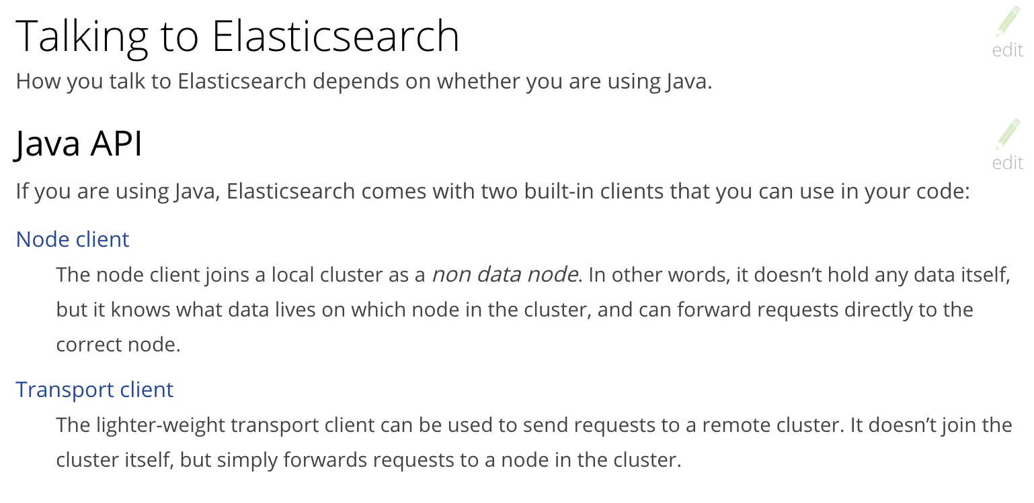

Slide 20
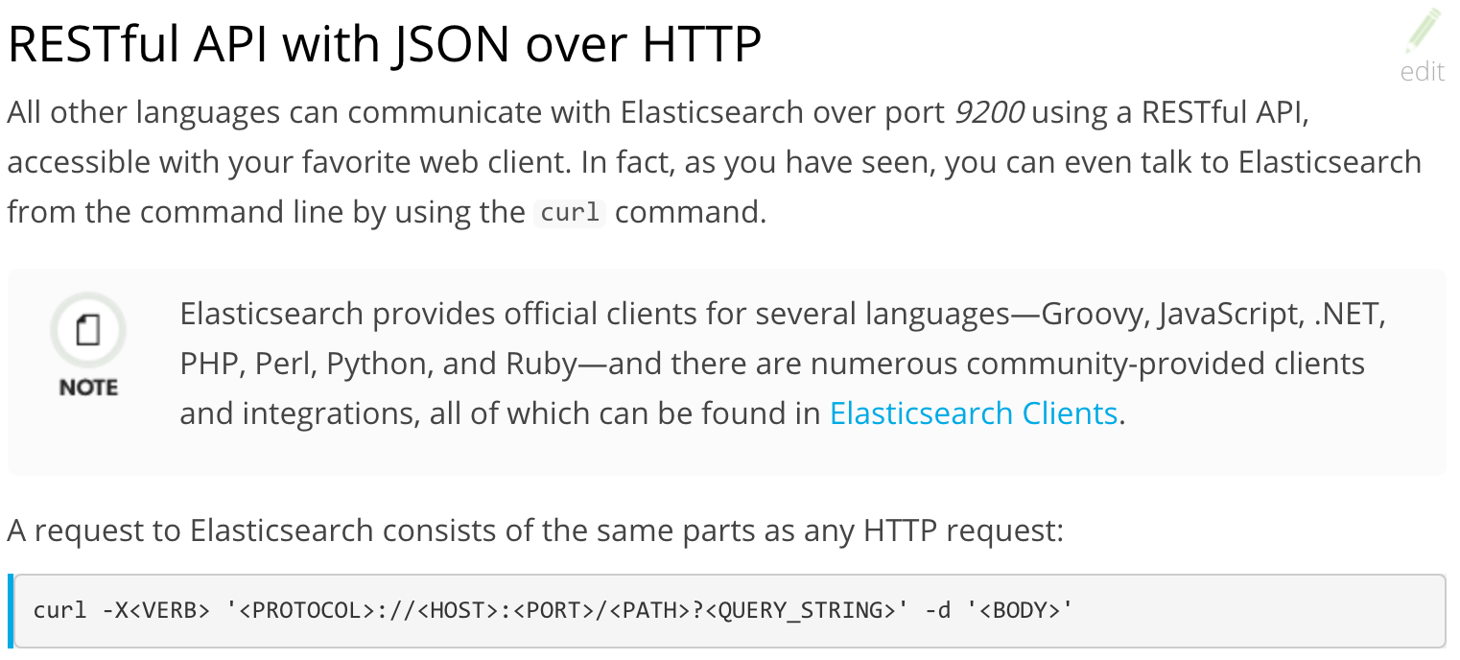

Slide 21
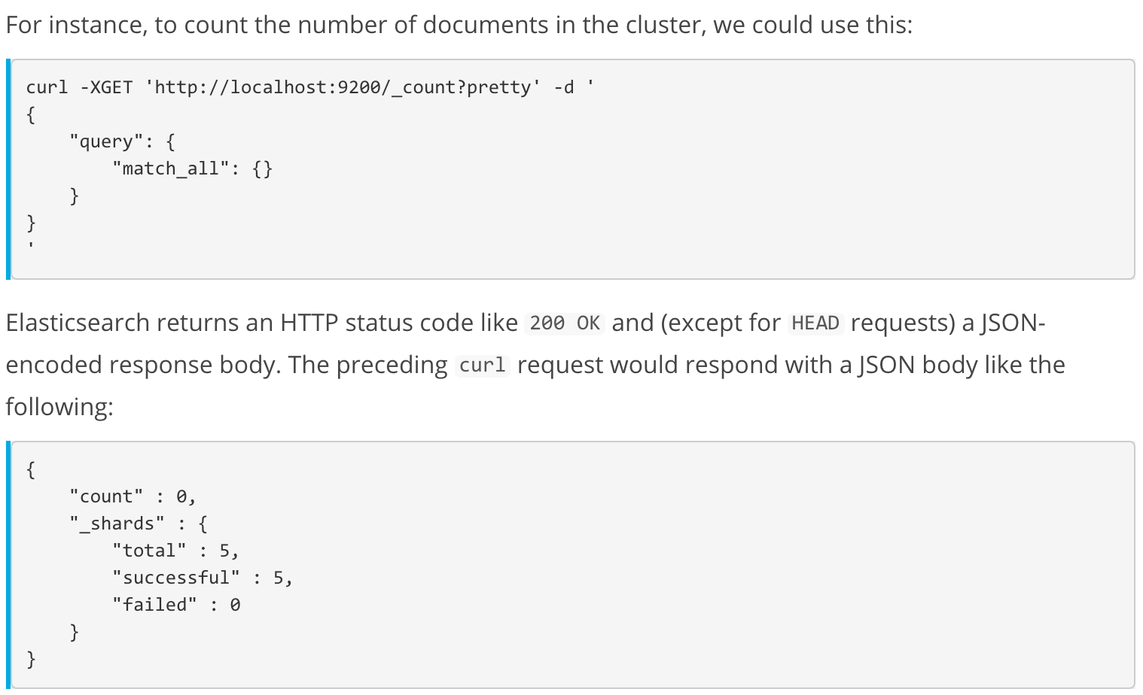

Slide 22
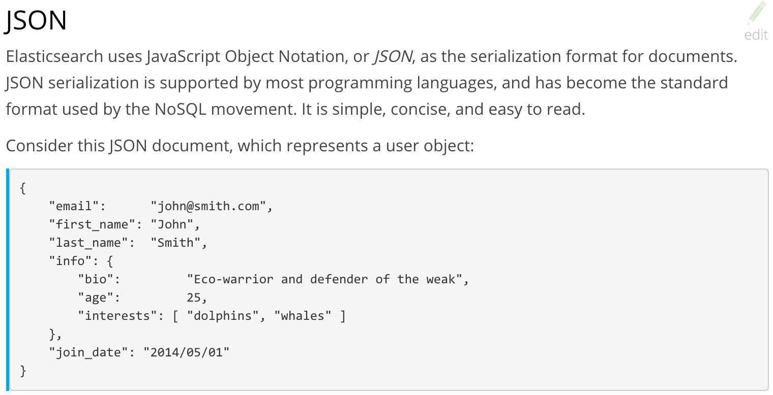

Slide 23
An Elasticsearch cluster can contain multiple indices,
which in turn contain multiple types.
These types hold multiple documents,
and each document has multiple fields

Slide 24
Installing Elasticsearch
Download and un-compress the file
Start <HOME>/bin/elasticsearch
Check the installation
curl -XGET 'localhost:9200/?pretty’

Slide 25
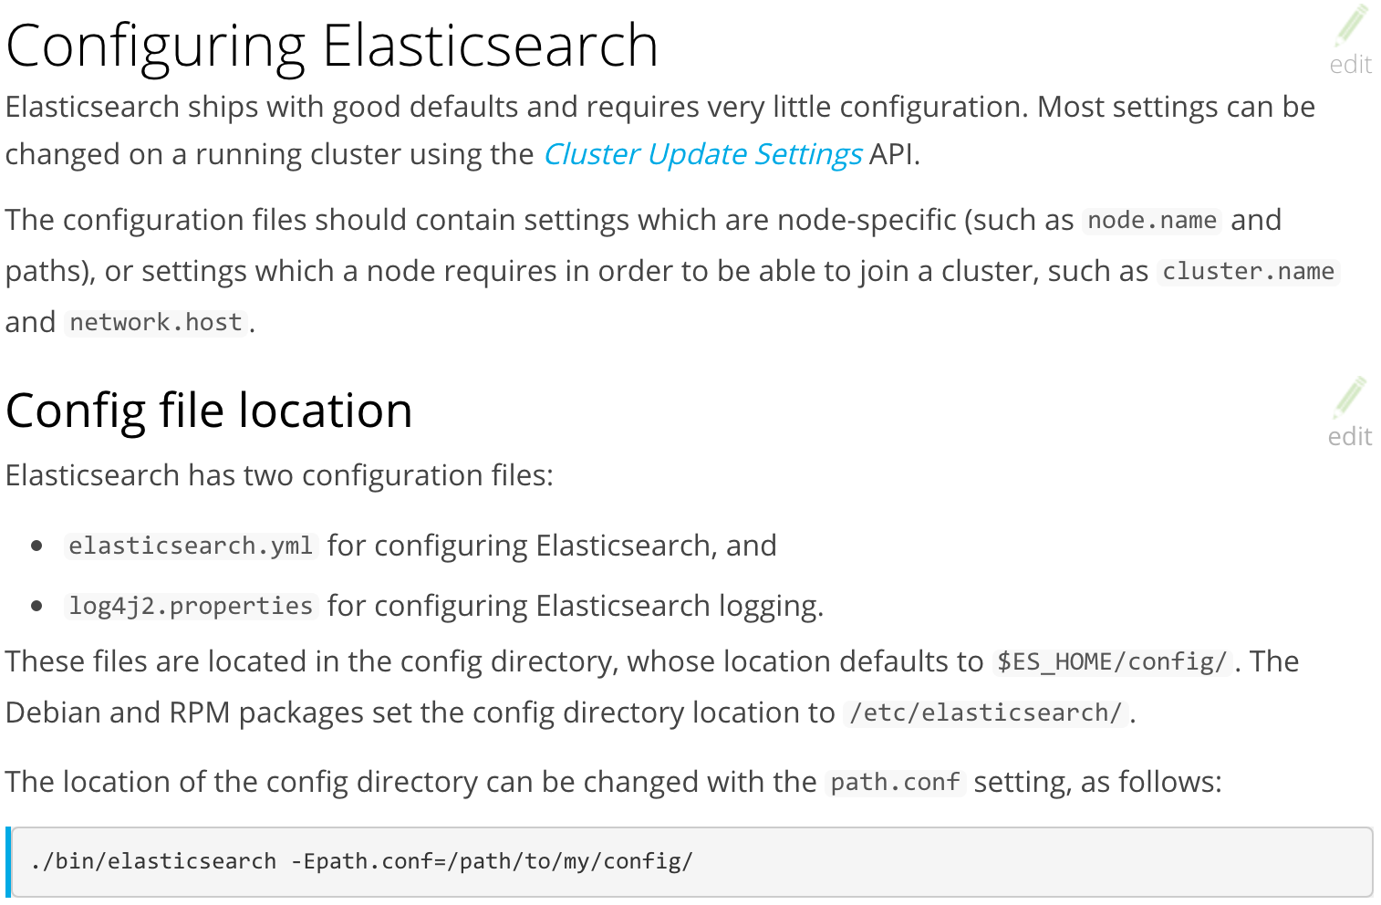

Slide 26
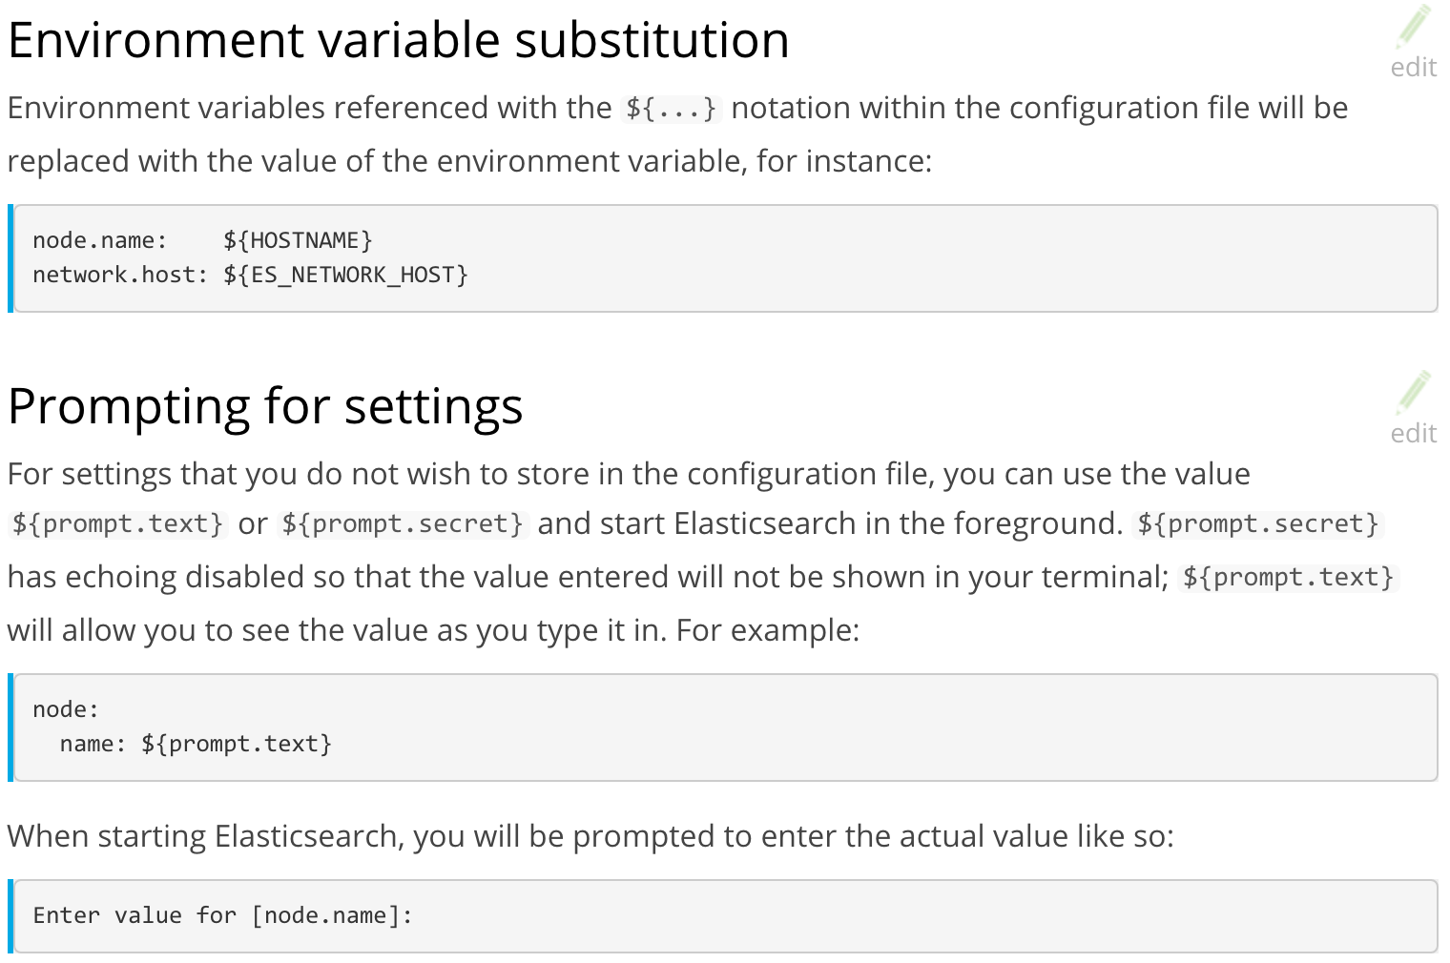

Slide 27
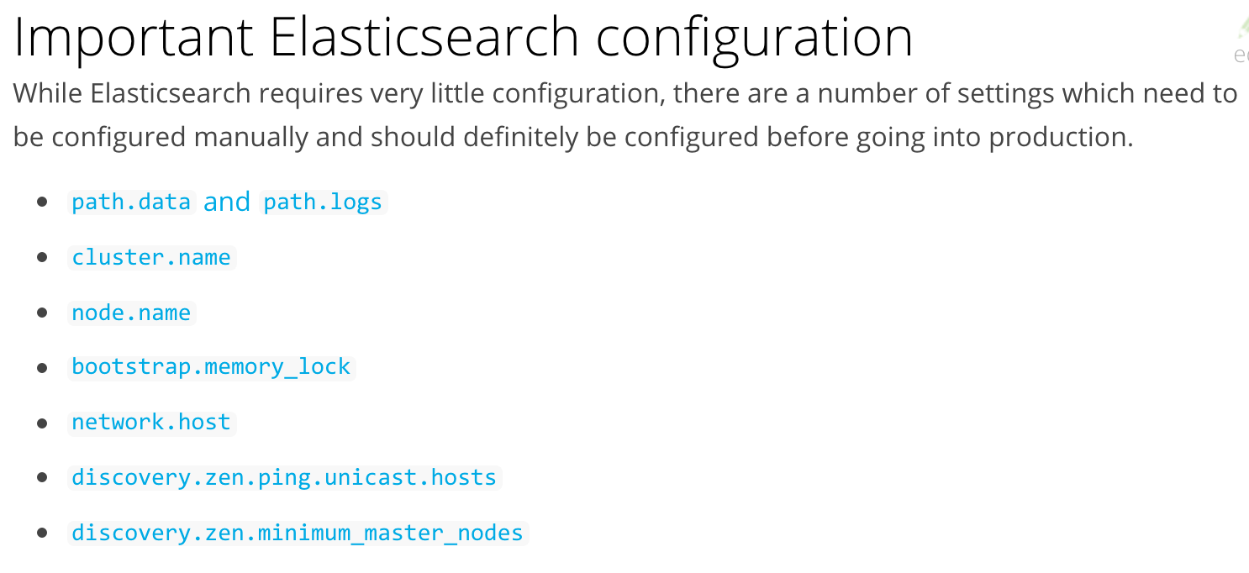

Slide 28
Index API
curl -XPUT 'localhost:9200/exilant/employee/1?pretty' -H 'Content-Type: application/json' -d'
{
"first_name" : "John",
"last_name" : "Smith",
"age" : 25,
"about" : "I love to go rock climbing",
"interests": [ "sports", "music" ]
}
’
curl -XGET 'localhost:9200/exilant/_settings?flat_settings=true&pretty'

Slide 29
curl -XPUT 'localhost:9200/exilant/employee/2?pretty' -H 'Content-Type: application/json' -d'
{
"first_name" : "Jane",
"last_name" : "Smith",
"age" : 32,
"about" : "I like to collect rock albums",
"interests": [ "music" ]
}
'
curl -XPUT 'localhost:9200/exilant/employee/3?pretty' -H 'Content-Type: application/json' -d'
{
"first_name" : "Douglas",
"last_name" : "Fir",
"age" : 35,
"about": "I like to build cabinets",
"interests": [ "forestry" ]
}
'

Slide 30
Dynamic mapping
Fields and mapping types do not need to be defined before being used. Thanks to dynamic mapping, new mapping types and new field names will be added automatically, just by indexing a document. New fields can be added both to the top-level mapping type, and to inner object and nested fields.
The dynamic mapping rules can be configured to customise the mapping that is used for new types and new fields.
Explicit mapping
You know more about your data than Elasticsearch can guess, so while dynamic mapping can be useful to get started, at some point you will want to specify your own explicit mappings.
You can create mapping types and field mappings when you create an index, and you can add mapping types and fields to an existing index with the PUT mapping API.

Slide 31
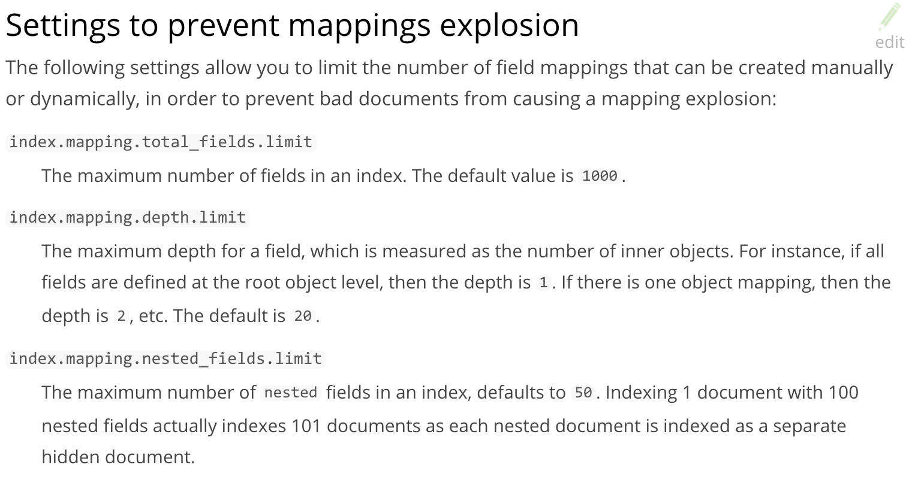

Slide 32
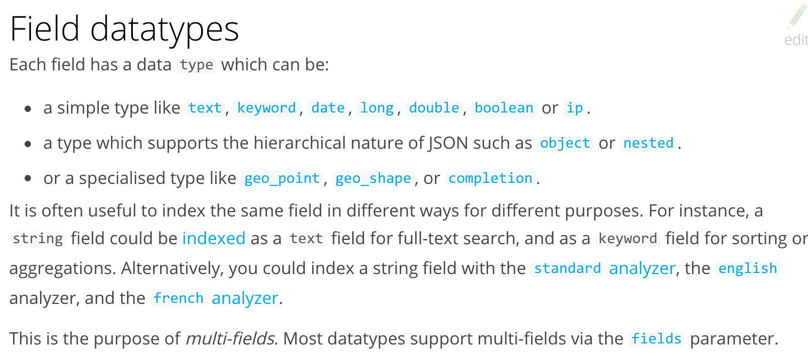

Slide 33
Create an Index
curl -XPUT 'localhost:9200/blogs?pretty' -H 'Content-Type: application/json' -d'
{
"settings" : {
"number_of_shards" : 3,
"number_of_replicas" : 1
}
}
'

Slide 34
Example Mapping
curl -XPUT 'localhost:9200/blogs?pretty' -H 'Content-Type: application/json' -d'
{
"mappings": {
"user": {
"_all": { "enabled": false },
"properties": {
"title": { "type": "text" },
"name": { "type": "text" },
"age": { "type": "integer" }
}
},
"blogpost": {
"_all": { "enabled": false },
"properties": {
"title": { "type": "text" },
"body": { "type": "text" },
"user_id": {
"type": "keyword"
},
"created": {
"type": "date",
"format": "strict_date_optional_time||epoch_millis"
}
}
}
}
}
'

Slide 35
Get API
curl -XGET 'localhost:9200/exilant/employee/1?pretty’
curl -XGET 'localhost:9200/exilant/employee/1?_source=false&pretty'
curl -XGET 'localhost:9200/exilant/employee/1?_source_include=*name&_source_exclude=last*&pretty'

Slide 36
Search API
curl -XGET 'localhost:9200/exilant/employee/_search?pretty'
curl -XGET 'localhost:9200/exilant/employee/_search?q=last_name:Smith&pretty'
curl -XGET 'localhost:9200/exilant/employee/_search?q=Smith&pretty'

Slide 37
Search With DSL
Query-string search is handy for ad hoc searches from the command line, but it has its limitations, Elasticsearch provides a rich, flexible, query language called the query DSL, which allows us to build much more complicated, robust queries. The DSL is specified using a JSON request body. We can represent the previous search for all Smiths like so:
curl -XGET 'localhost:9200/exilant/employee/_search?pretty' -H 'Content-Type: application/json' -d'
{
"query" : {
"match" : {
"last_name" : "Smith"
}
}
}
‘

Slide 38
More complicated searches
curl -XGET 'localhost:9200/exilant/employee/_search?pretty' -H 'Content-Type: application/json' -d'
{
"query" : {
"bool" : {
"must" : {
"match" : {
"last_name" : "smith"
}
},
"filter" : {
"range" : {
"age" : { "gt" : 30 }
}
}
}
}
}
'

Slide 39
Full Text Search
curl -XGET 'localhost:9200/exilant/employee/_search?pretty' -H 'Content-Type: application/json' -d'
{
"query" : {
"match" : {
"about" : "rock climbing"
}
}
}
'

Slide 40
Phrase Search
curl -XGET 'localhost:9200/exilant/employee/_search?pretty' -H 'Content-Type: application/json' -d'
{
"query" : {
"match_phrase" : {
"about" : "rock climbing"
}
}
}
'

Slide 41
Highlight Search
curl -XGET 'localhost:9200/exilant/employee/_search?pretty' -H 'Content-Type: application/json' -d'
{
"query" : {
"match_phrase" : {
"about" : "rock climbing"
}
},
"highlight": {
"fields" : {
"about" : {}
}
}
}
'

Slide 42
Retrieving Part of Document
curl -XGET 'localhost:9200/exilant/employee/1?_source=title,text&pretty'
Checking if Document Exists
curl -i -XHEAD http://localhost:9200/exilant/employee/123
Deleting Document
curl -XDELETE 'localhost:9200/exilant/employee/123?pretty'

Slide 43
Update API
curl -XPUT 'localhost:9200/exilant/employee/1?pretty' -H 'Content-Type: application/json' -d '
{
"first_name" : "Douglas",
"last_name" : "Fir",
"age" : 35,
"about": "I like to build cabinets",
"interests": [ "forestry" ]
}
'
curl -XPOST 'localhost:9200/exilant/employee/1/_update?pretty' -H 'Content-Type: application/json' -d'
{
"script" : "ctx._source.last_name = \"Kumar\""
}
’
curl -XGET 'localhost:9200/exilant/employee/1?pretty'

Slide 44
Delete API
curl -XDELETE 'http://localhost:9200/exilant/employee/1'

Slide 45
Delete by Query API
curl -XPOST 'http://localhost:9200/exilant/employee/_delete_by_query?pretty' -H 'Content-Type: application/json' -d'
{
"query": {
"match": {
"about" : "rock climbing"
}
}
}
'

Slide 46
Scripting with Groovy
For those moments when the API just isn’t enough,
Elasticsearch allows you to write your own custom logic in a script.
Scripting is supported in many APIs including search, sorting, aggregations, and document updates.
Scripts can be passed in as part of the request, retrieved from the special .scripts index, or loaded from disk.
The default scripting language is Groovy, a fast and expressive scripting language, similar in syntax to JavaScript. It was first introduced in Elasticsearch version v1.3.0 and it runs in a sandbox, however there is vulnerability in the Groovy scripting engine that allows an attacker to construct Groovy scripts that escape the sandbox and execute shell commands as the user running the Elasticsearch Java VM.

Slide 47
Scripting with Groovy
In versions v1.3.8, v1.4.3, and version v1.5.0 and newer it has been disabled by default. Alternatively you can disable dynamic Groovy scripts by adding this setting to the config/elasticsearch.yml file in all nodes in the cluster:
script.groovy.sandbox.enabled: false
This will turn off the Groovy sandbox, thus preventing dynamic Groovy scripts from being accepted as part of a request or retrieved from the special .scripts index. You will still be able to use Groovy scripts stored in files in the config/scripts/ directory on every node.
If your architecture and security is one that does not need worry about the vulnerability, for example your Elasticsearch endpoints are only exposed and available to trusted applications, then you can choose to re-enable the dynamic scripting if it is a feature your application needs.

Slide 48
Scripting with Painless
curl -XPOST 'localhost:9200/website/blog/1/_update?pretty' -H 'Content-Type: application/json' -d'
{
"script": {
"lang": "painless",
"inline": "ctx._source.tags.add(params.tags)",
"params": {
"tags": "search"
}
}
}
'

Slide 49
Updates and Conflicts
For many uses of partial update, it doesn’t matter that a document has been changed. For instance, if two processes are both incrementing the page-view counter, it doesn’t matter in which order it happens; if a conflict occurs, the only thing we need to do is reattempt the update
curl -XPOST 'localhost:9200/website/pageviews/1/_update?retry_on_conflict=5&pretty' -H 'Content-Type: application/json' -d'
{
"script" : "ctx._source.views+=1",
"upsert": {
"views": 0
}
}
‘

Slide 50
Retrieving multiple Documents
curl -XGET 'localhost:9200/_mget?pretty' -H 'Content-Type: application/json' -d'
{
"docs" : [
{
"_index" : "website",
"_type" : "blog",
"_id" : 2
},
{
"_index" : "website",
"_type" : "pageviews",
"_id" : 1,
"_source": "views"
}
]
}
'

Slide 51
Retrieving multiple Documents
curl -XGET 'localhost:9200/blog/_mget?pretty' -H 'Content-Type: application/json' -d'
{
"ids" : [ "2", "1" ]
}

Slide 52
Bulk Operations
{ action: { metadata }}\n
{ request body }\n
{ action: { metadata }}\n
{ request body }\n
…
The action/metadata line specifies what action to do to which document.
The action must be one of the following:
Create : Create a document only if the document does not already exist.
Index: Create a new document or replace an existing document.
Update: Do a partial update on a document.
Delete : Delete a document.
The metadata should specify the _index, _type, and _id of the document to be indexed, created, updated, or deleted.

Slide 53
Bulk Operations
curl -XPOST 'localhost:9200/_bulk?pretty' -H 'Content-Type: application/json' -d'
{ "delete": { "_index": "website", "_type": "blog", "_id": "123" }}
{ "create": { "_index": "website", "_type": "blog", "_id": "123" }}
{ "title": "My first blog post" }
{ "index": { "_index": "website", "_type": "blog" }}
{ "title": "My second blog post" }
{ "update": { "_index": "website", "_type": "blog", "_id": "123", "_retry_on_conflict" : 3} }
{ "doc" : {"title" : "My updated blog post"} }
'

Slide 54
Bulk Operations.. Response
{
"took": 4,
"errors": false,
"items": [
{ "delete": {
"_index": "website",
"_type": "blog",
"_id": "123",
"_version": 2,
"status": 200,
"found": true
}},
{ "create": {
"_index": "website",
"_type": "blog",
"_id": "123",
"_version": 3,
"status": 201
}},
{ "create": {
"_index": "website",
"_type": "blog",
"_id": "EiwfApScQiiy7TIKFxRCTw",
"_version": 1,
"status": 201
}},
{ "update": {
"_index": "website",
"_type": "blog",
"_id": "123",
"_version": 4,
"status": 200
}}
]
}

Slide 55
Bulk Operations
curl -XPOST 'localhost:9200/_bulk?pretty' -H 'Content-Type: application/json' -d'
{ "create": { "_index": "website", "_type": "blog", "_id": "123" }}
{ "title": "Cannot create - it already exists" }
{ "index": { "_index": "website", "_type": "blog", "_id": "123" }}
{ "title": "But we can update it" }
’
{
"took": 3,
"errors": true,
"items": [
{ "create": {
"_index": "website",
"_type": "blog",
"_id": "123",
"status": 409,
"error": "DocumentAlreadyExistsException
[[website][4] [blog][123]:
document already exists]"
}},
{ "index": {
"_index": "website",
"_type": "blog",
"_id": "123",
"_version": 5,
"status": 200
}}
]
}

Slide 56
Bulk Operations
Bulk requests are not atomic
They cannot be used to implement transactions.
Each request is processed separately, so the success or failure of one request will not interfere with the others.

Slide 57
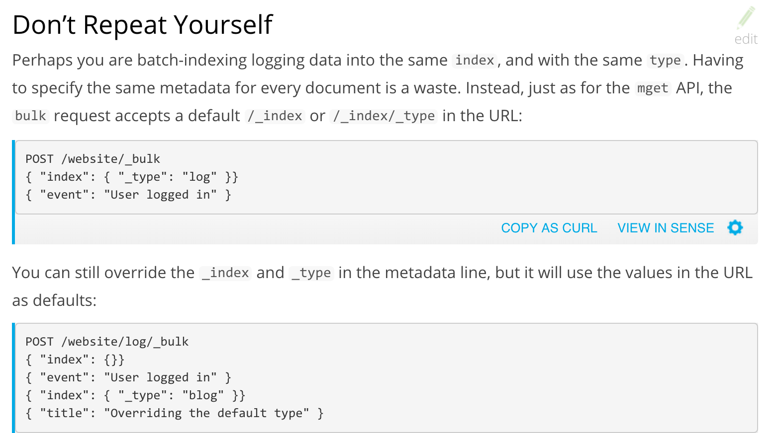

Slide 58
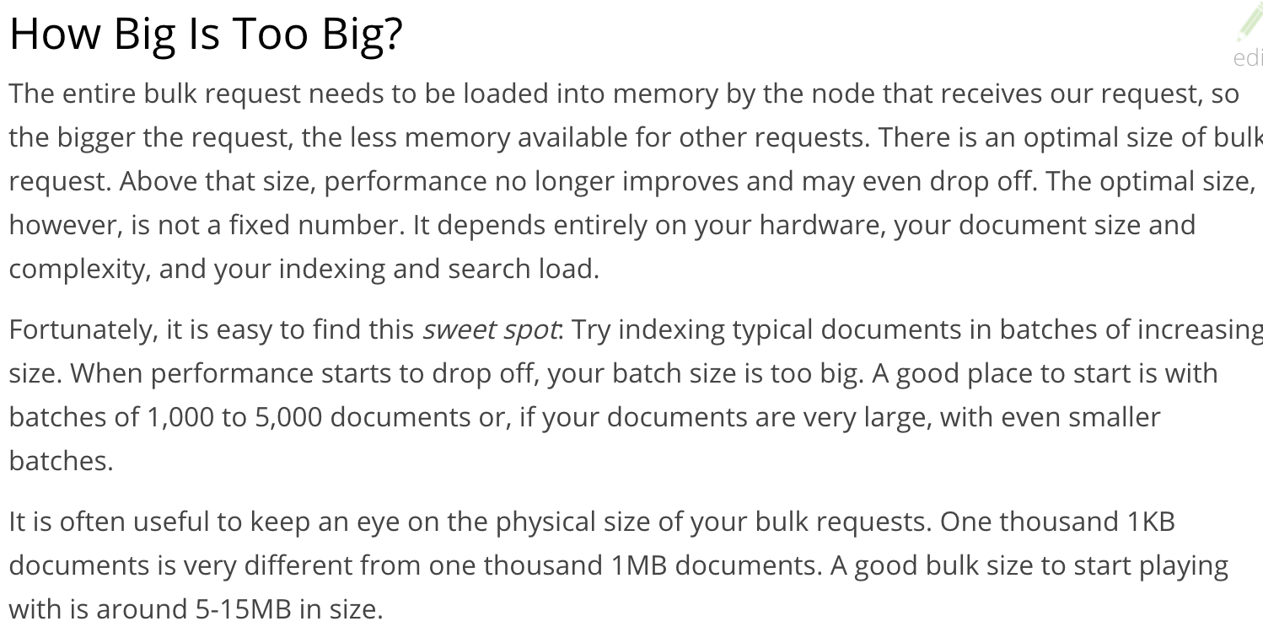

Slide 59
Analytics
Elasticsearch has functionality called aggregations, which allow you to generate sophisticated analytics over your data. It is similar to GROUP BY in SQL, but much more powerful.
For example, let’s find the most popular interests enjoyed by our employees::
curl -XGET 'localhost:9200/exilant/employee/_search?pretty' -H 'Content-Type: application/json' -d'
{
"aggs": {
"all_interests": {
"terms": { "field": "interests" }
}
}
}
'

Slide 60
Analytics continued…
curl -XGET 'localhost:9200/exilant/employee/_search?pretty' -H 'Content-Type: application/json' -d'
{
"query": {
"match": {
"last_name": "smith"
}
},
"aggs": {
"all_interests": {
"terms": {
"field": "interests"
}
}
}
}
'

Slide 61
Analytics continued…
curl -XGET 'localhost:9200/exilant/employee/_search?pretty' -H 'Content-Type: application/json' -d'
{
"aggs" : {
"all_interests" : {
"terms" : { "field" : "interests" },
"aggs" : {
"avg_age" : {
"avg" : { "field" : "age" }
}
}
}
}
}
'

Slide 62
Versioning in ElasticSearch

Slide 63
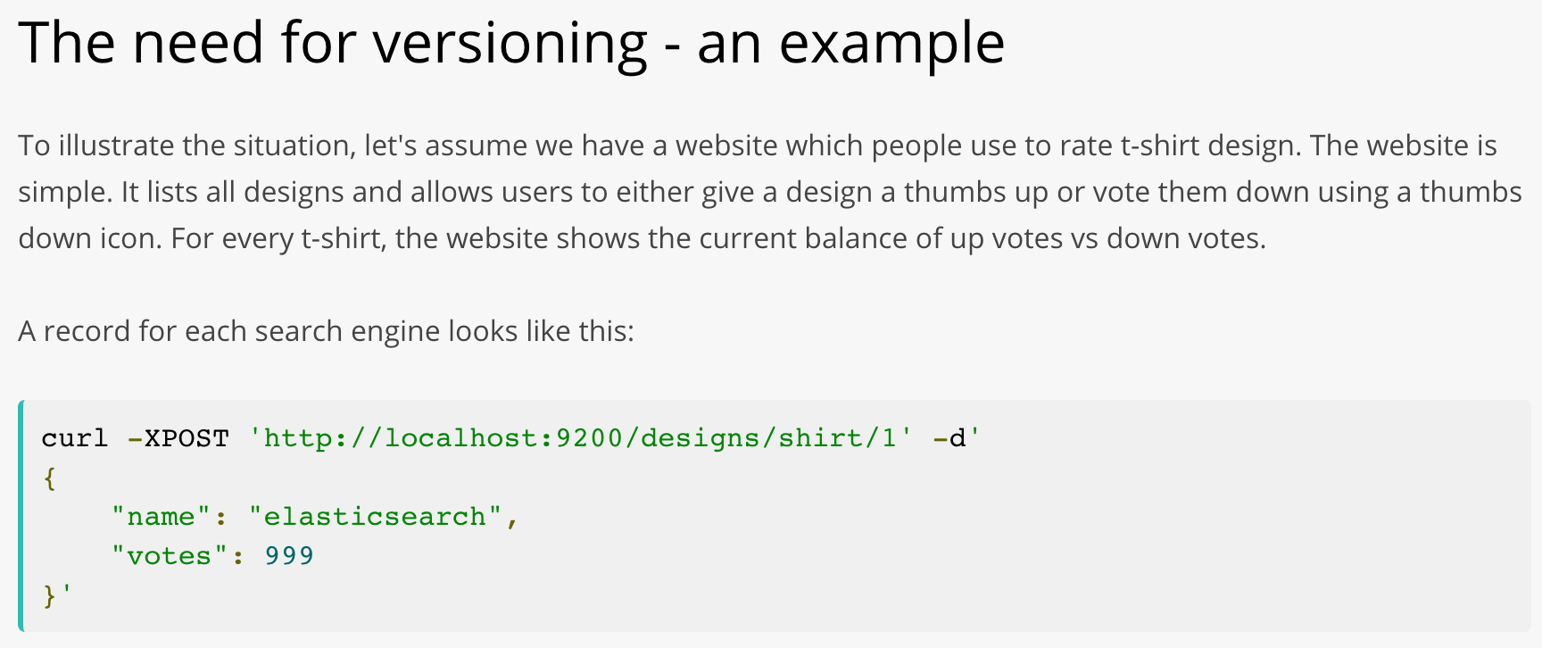

Slide 64
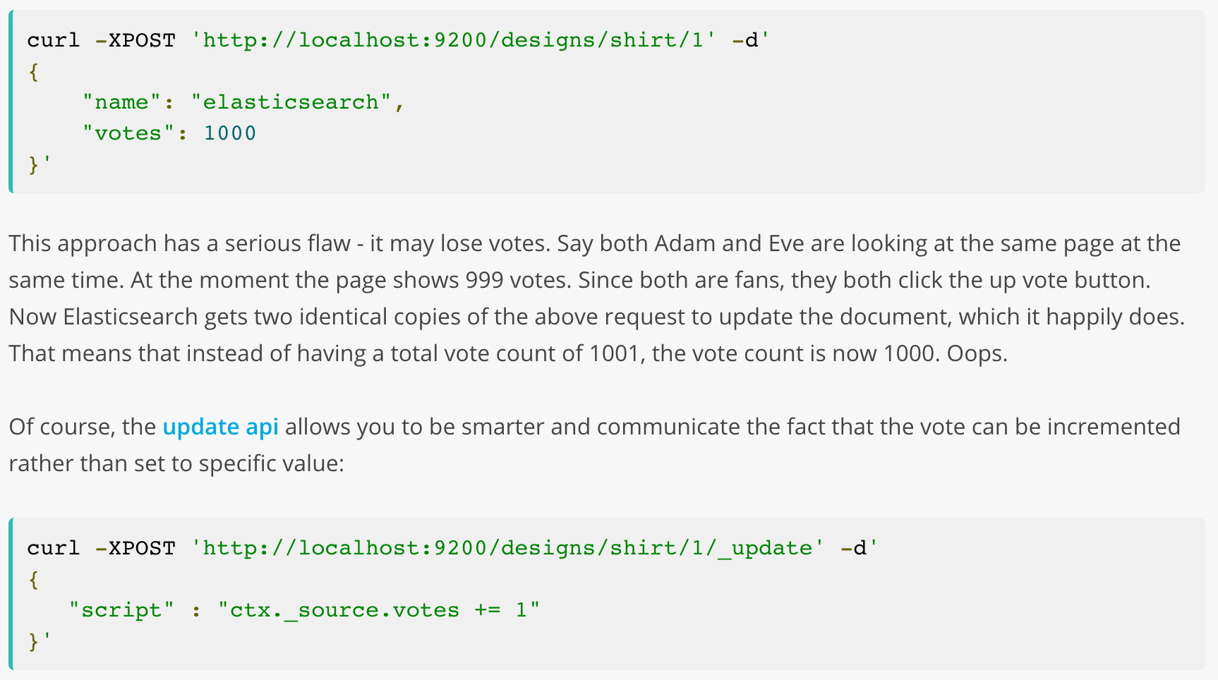
Optimistic locking
200 OK
409 Conflict
Version Check - Optional

Slide 65
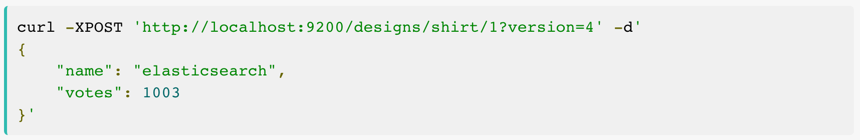
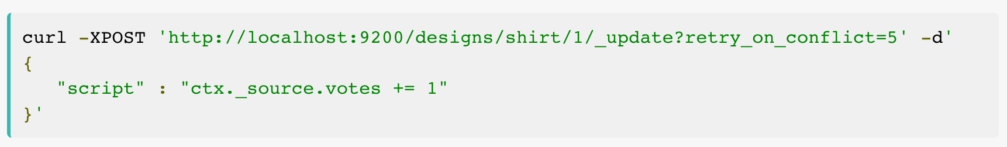

Slide 66
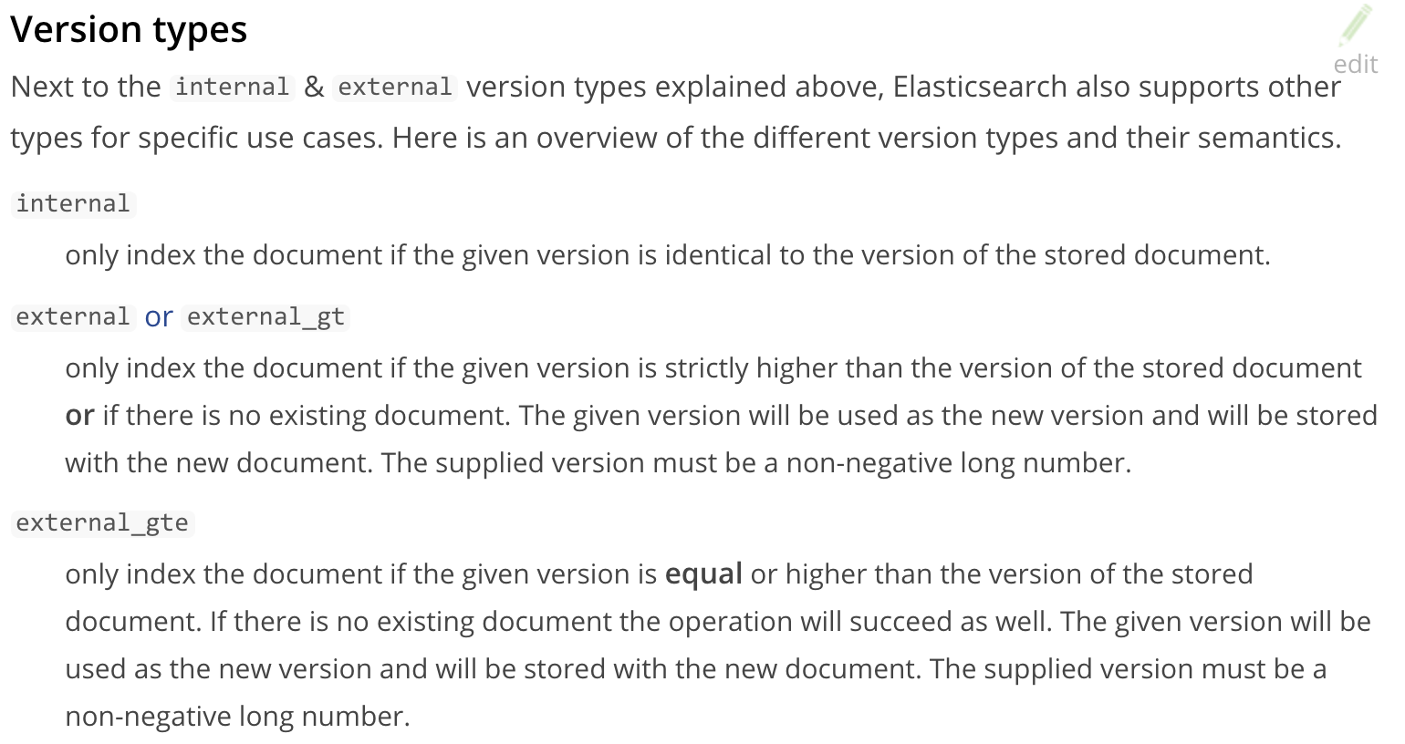

Slide 67
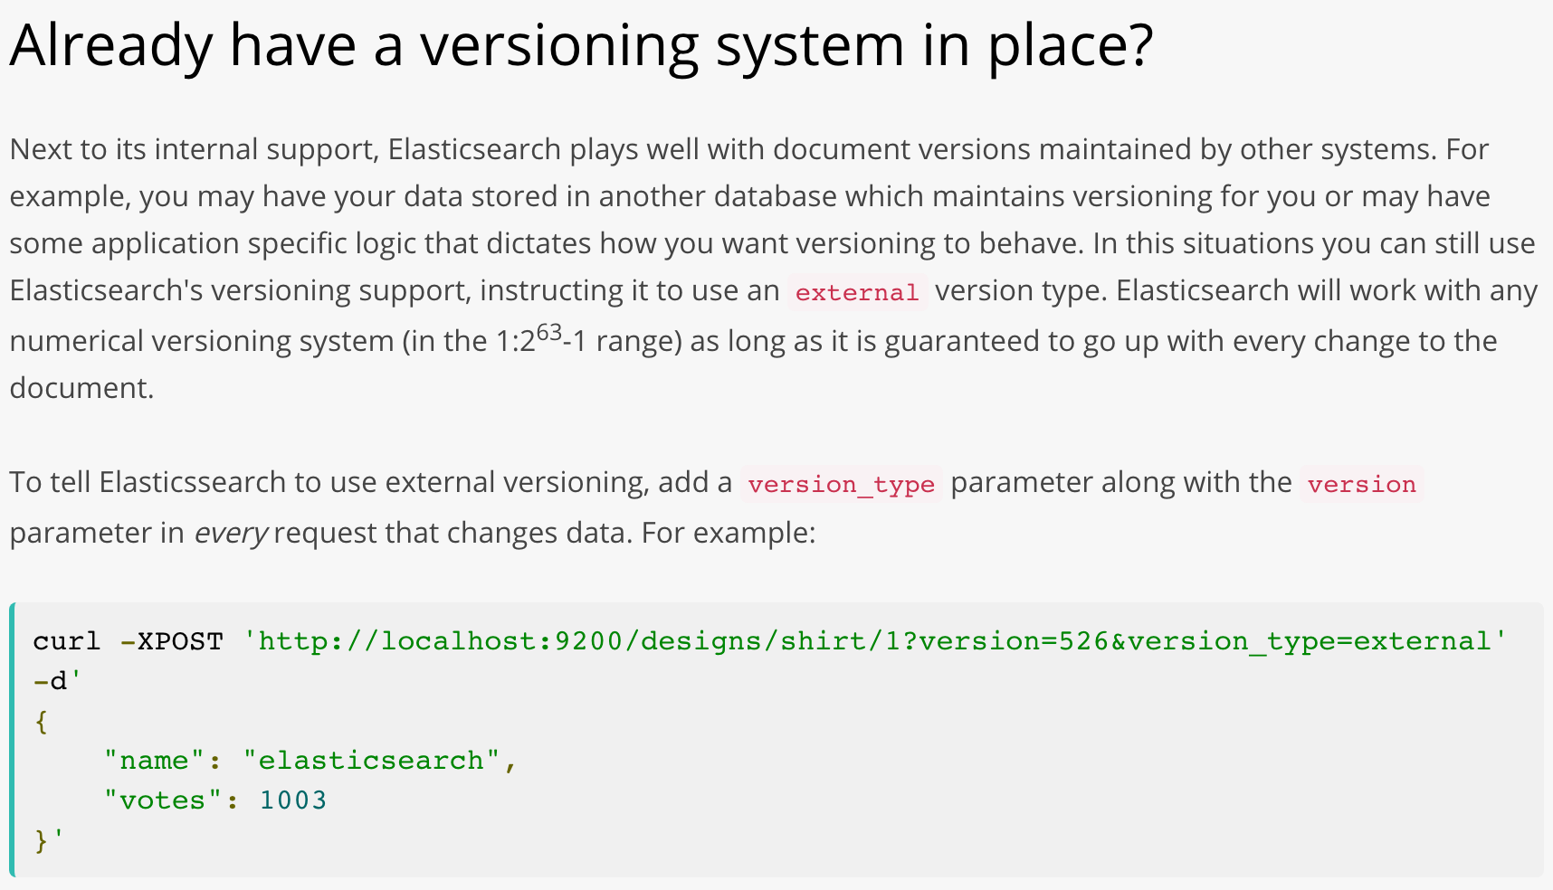

Slide 68
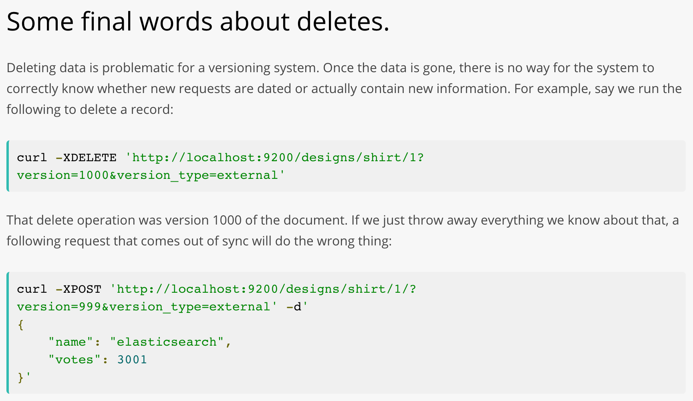
Deletes garbage collection
index.gc_deletes

